Slide 1
My PayPal
Credit Card Fraud Detection - binary classification with highly imbalanced dataset
Nikolay Kirilov, student at Amsterdam Tech

Slide 2
Problem definition
The task is to train a model that lowers the false positives while the true positives do not change much.
So, the fee losses from stopped transactions to be as lower as possible for the fictional bank.
The success criteria is to achieve AUC score of more than 79% which is the AUC score of the baseline LogisticRegression model.

Slide 3
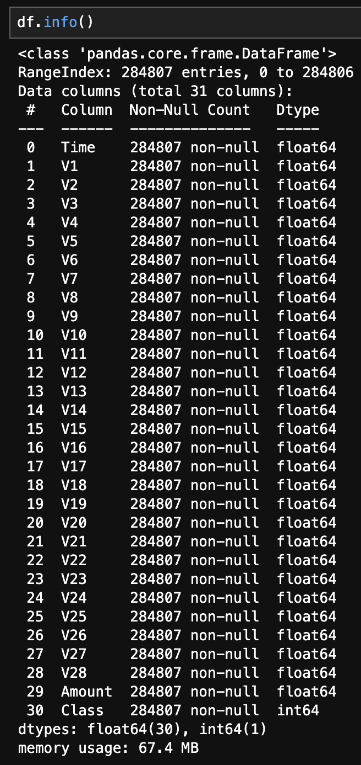
Data
The genres data can be found on Kaggle: https://www.kaggle.com/datasets/mlg-ulb/creditcardfraud
Most of the features are a result of a PCA and the whole data is anonymised. The target is “Class” and its values are 1 and 0.

Slide 4
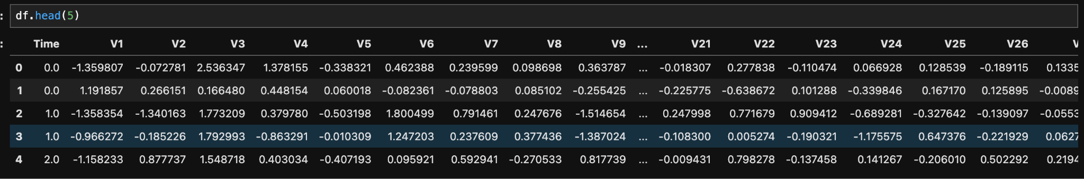
Exploratory Data Analysis
I have started with a basic info and a head of the dataset to famiralize myself.

Slide 5
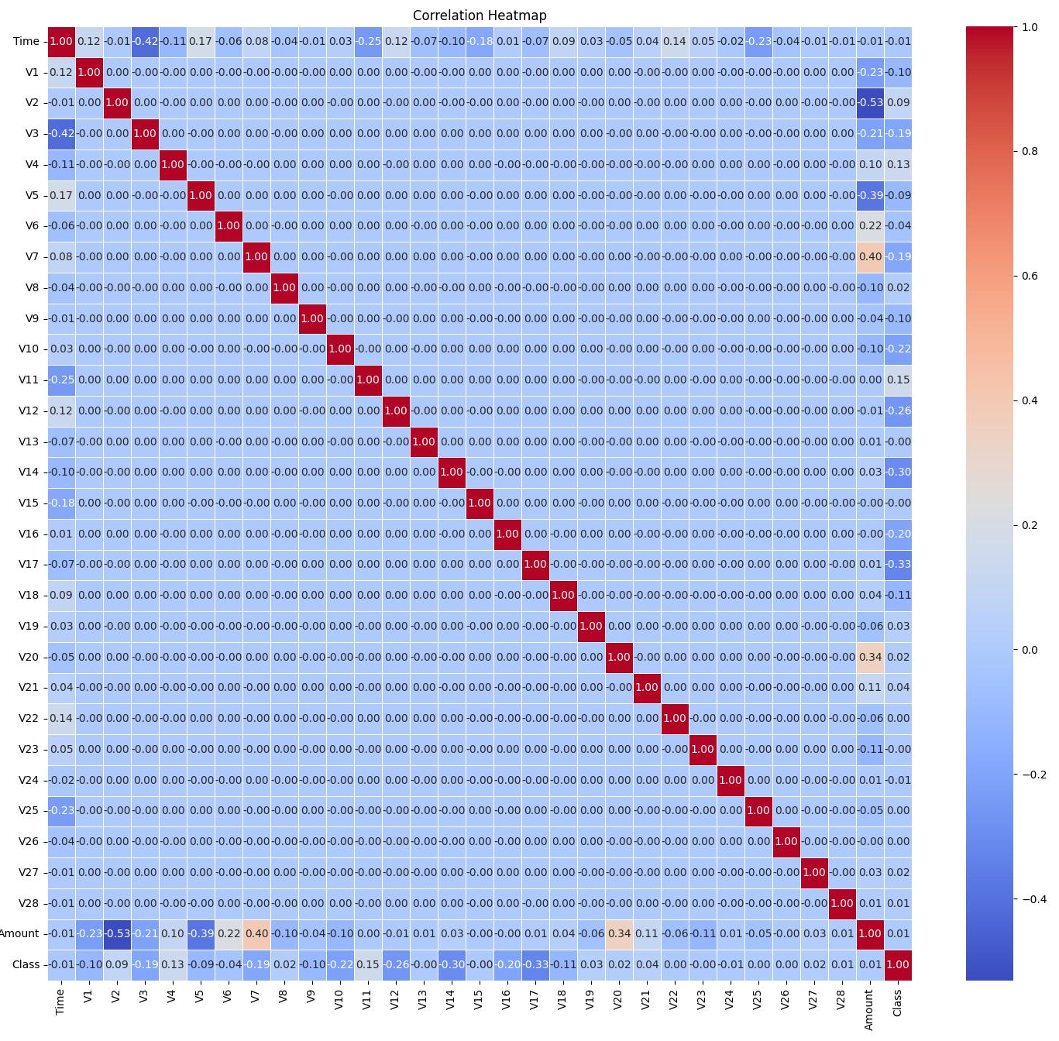
Exploratory Data Analysis
Then, I created a correlation matrix to better understand the features and to use it later for feature selection.

Slide 6
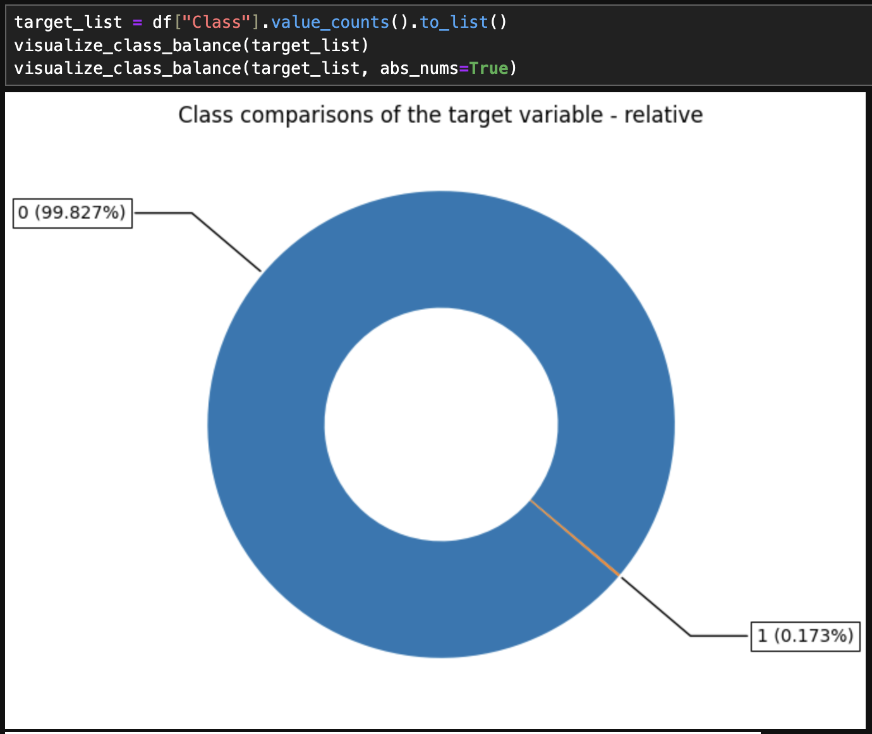
Exploratory Data Analysis
After the matrix, probably the most important part of the EDA came, checking the class balance. Here it became clear that I must do something either oversampling or under sampling.

Slide 7
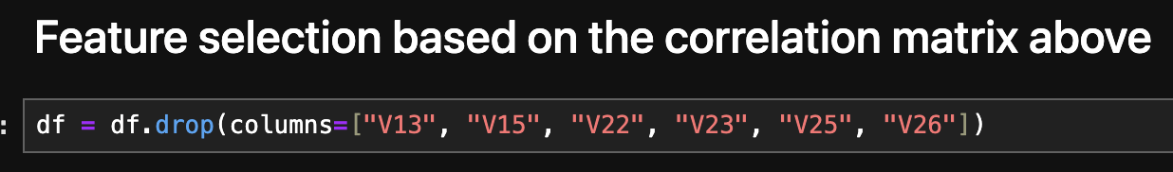
Data Preprocessing
After the EDA, I performed feature selection by utilizing the correlation matrix earlier created. This step, lowered the training time significantly with more than 40 sec - from 3:25 min to 2:39 min. In scale, this could save a lot of time and resources.

Slide 8
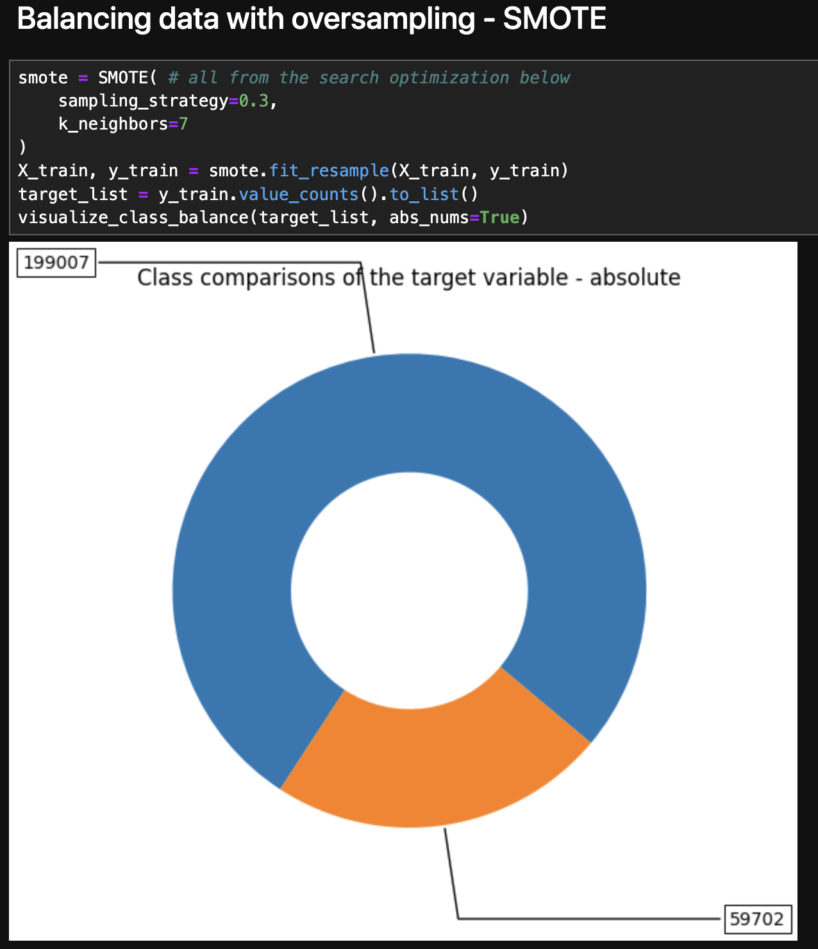
Data Preprocessing
After, the feature selection, I did the train/test split and performed oversampling using SMOTE and two hyperparameters that I figured out while doing hyperparameter search using the optuna library. I decided to use oversampling, because in the most of the papers I read it turns out that it improves the performance more than the undersampling, which can be expected having in mind the imbalance in this dataset.
Main paper

Slide 9
Methodology
As a classification problem, I utilized LogisticRegression from scikit-learn library as a baseline model that achieved AUC score of 79%. I used Random Forest classifier for the main model. The train/split was put to - 70/30. Then, I started performing multiple experiments while changing a single thing and monitoring the results with Mlflow. Finally, performed hyperparameter search with which the AUC became 91% while the training time was lowered more.

Slide 10
Experiments & Results
I have conducted numerous experiments. I have tested different algorithms at the beginning, however, the Random Forest Classifier performed the best. After this,I have started with a plain Random Forest model. Then, I started adding more and more to it while following the Google’s paper that suggests a scientific approach for model improving. After all, I have achieved a somewhat good model with an AUC score of 91%.

Slide 11
Conclusion & Future work
In conclusion, I learnt a lot about working with imbalanced data and balancing it. The neural model I built is not the best, however, I would say the data is limiting. The best model I found in my research had 94.5% AUC while mine achieved a little more than 91%. Based on that I would assume that the model built by me is good enough and could be used by the fictional bank.
During the researching and working, I found that there are other ways to solve the problem by scraping and adding more that which indeed would be useful. Moreover, I believe that with more work on the features and the hyperparameters, it may be possible to achieve even more than 94.5% AUC. This would be a perfect continuation of the project as future work.

